Slide 1
Network Security
Assignment 3
Herschelle Gupta 2019045
Ritik Vatsal 2019321

Slide 2
Project 0
RSA-based Public-key Certification Authority (CA)
Public Key Certifying Authority
2 Clients - Alice and Bob

Slide 3
Assumptions
Everyone knows their own Private & Public Key
The clients - Alice and Bob, know the Public Key of the Certificate Authority
The CA has Public Keys of all clients
Message sizes limited to character 7 characters
Alice is implemented as a client program, Bob and CA are implemented as servers.
Decryption is done automatically at the servers but on client side (Alice), it has to be done with the help of given functions.

Slide 4
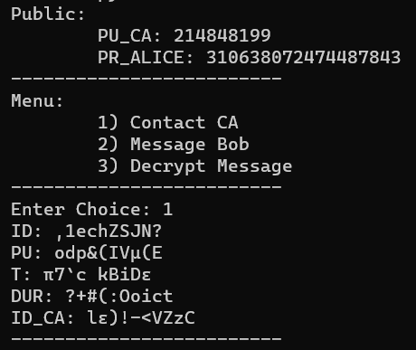
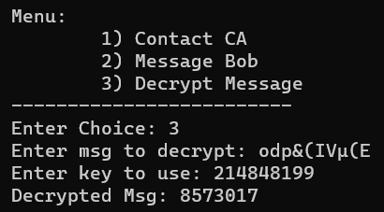
Understanding Input/Output
1. Alice requests Bob’s key from CA
2. Alice Decrypts CA’s message using CA’s Public Key

Slide 5
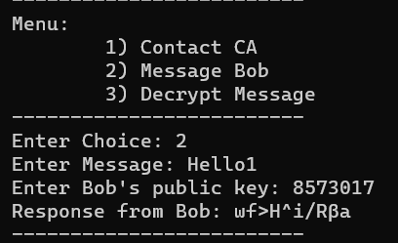

Understanding Input/Output
3. Alice uses this key to send Bob message
4. Bob does previous steps and decodes Alice’s message (Automatically)

Slide 6
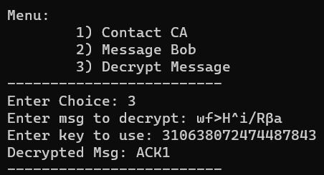
Understanding Input/Output
Repeat these steps for communication.
5. Finally, Alice uses her Private key to decrypt Bob’s reply

Slide 7
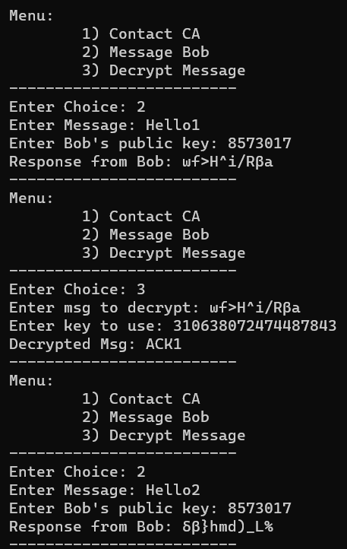
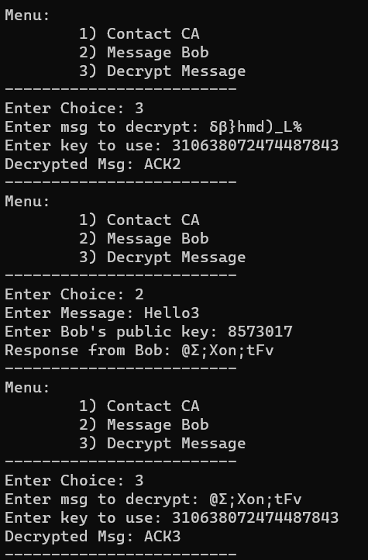
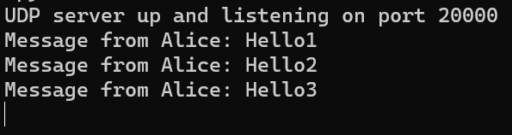
Test
Alice sends Hello1, Hello2, and Hello3, and Bob responds with Ack1, Ack2 and Ack3, respectively.
Bob
Alice

Slide 8
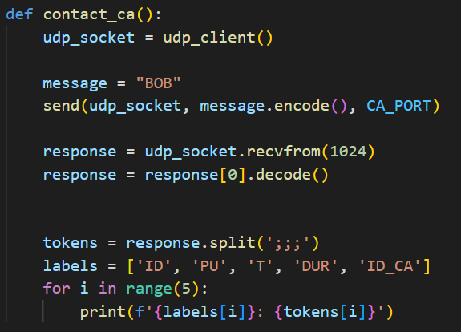
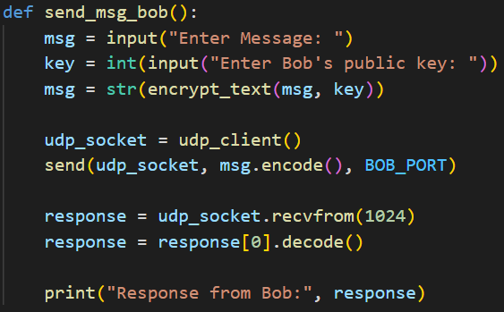
Working - Alice (& Bob)
Requesting Bob’s certificate from the Certificate Authority.
Sending messages to Bob

Slide 9
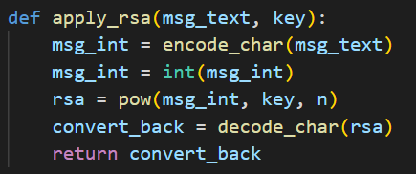
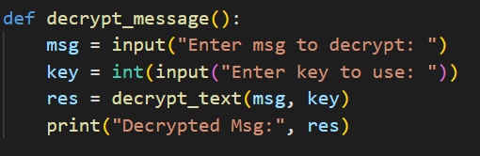

Working - Alice (& Bob)
Decrypting Messages
Utility functions for RSA.

Slide 10
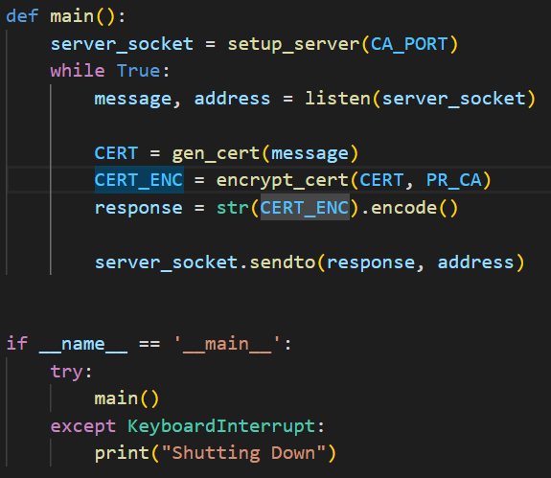
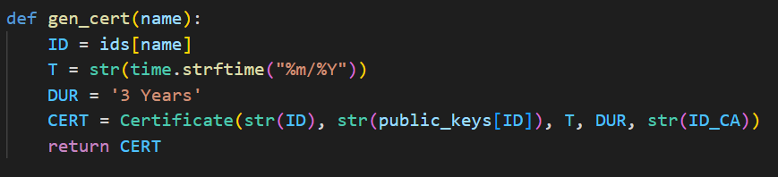
Working - Certificate Authority
Certificate generation Adding Time stamps and Validity
CA Listening using UDP

Slide 11
Thank You!

